Slide 1
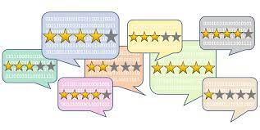
PRODUCT REVIW RATING PREDICATION USING NLP
-Yash Bhardwaj

Slide 2
Outline
Introduction (Problem Statement and Review of Literature)
Dataset Information
Data Pre-processing and Visualization
Building Models
Best Model
Conclusion

Slide 3

Introduction
The rise in E - commerce, has brought a significant rise in the importance of customer reviews. There are hundreds of review sites online and massive amounts of reviews for every product. Customers have changed their way of shopping and according to a recent survey, 70 percent of customers say that they use rating filters to filter out low rated items in their searches.
The ability to successfully decide whether a review will be helpful to other customers and thus give the product more exposure is vital to companies that support these reviews, companies like Google, Amazon and Yelp!
Problem Statement
- We have to build an application which can predict the rating by seeing the review.

Slide 4
Review of literature
According to the Lackermair, Kailer and Kanmaz (2013), product reviews and ratings represent an important source of information for consumers and are helpful tools in order to support their buying decisions. They also found out that consumers are willing to compare both positive and negative reviews when searching for a specific product. The authors argue that customers need compact and concise information about the products.
Therefore, consumers first need to pre-select the potential products matching their requirements. With this aim in mind, consumers use the star ratings as an indicator for selecting products. Later, when a limited number of potentials products have been chosen, reading the associated text review will reveal more details about the products and therefore help consumers making a final decision. It becomes daunting and time-consuming to compare different products in order to eventually make a choice between them. Therefore, models able to predict the user rating from the text review are critically important (Baccianella, Esuli & Sebastiani, 2009).

Slide 5
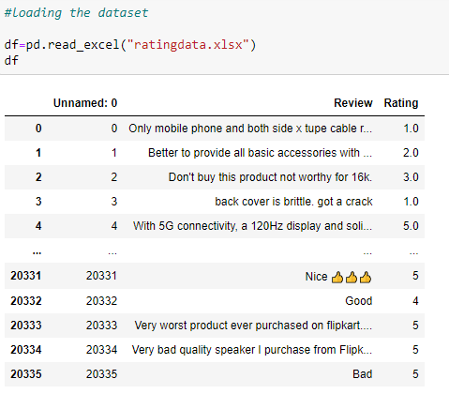
Dataset Information
Data is collected from e-commerce websites amazon.in and flipkart.com using selenium and saved in excel file.
Data is scraped for different electronic products like smartphone, speakers, monitors, printers etc.
Total data scraped is around 20000 rows of data.

Slide 6

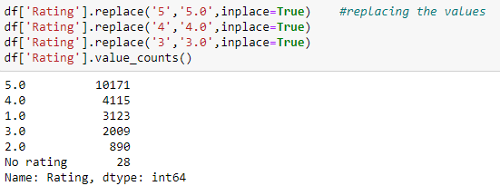
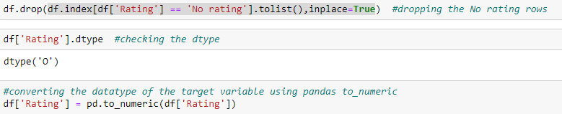
Data Pre-Processing and Visualization
Firstly null values present inside ‘Review’ variable were replaced:
Afterwards, we replaced values of the target variable, dropped ‘No rating’ values and converted the variable into numeric one.

Slide 7
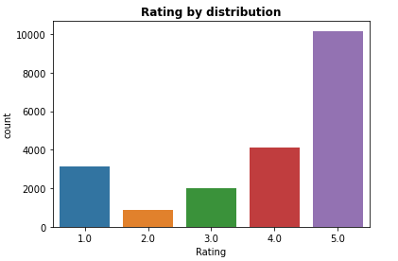
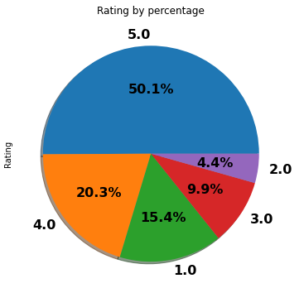
Observation:
More than 50% of customers have given a 5-star rating
Around 4% only customers have given a 2-star rating

Slide 8
Word Cloud:
Word Cloud is a visualization technique for text data wherein each word is picturized with its importance in the context or its frequency.
The more commonly the term appears within the text being analysed, the larger the word appears in the image generated.
The enlarged texts are the greatest number of words used there and small texts are the smaller number of words used.

Slide 9
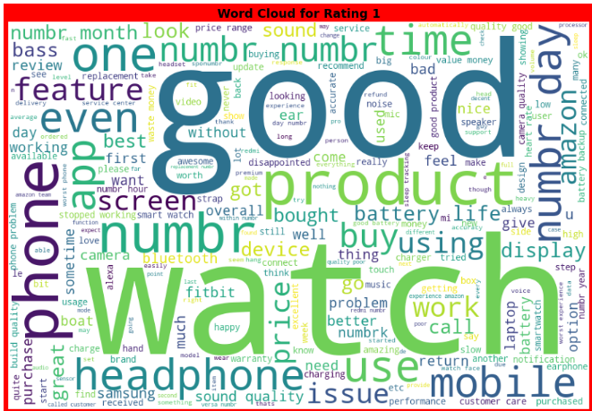

Slide 10
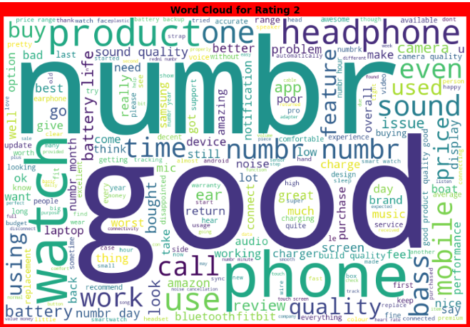

Slide 11
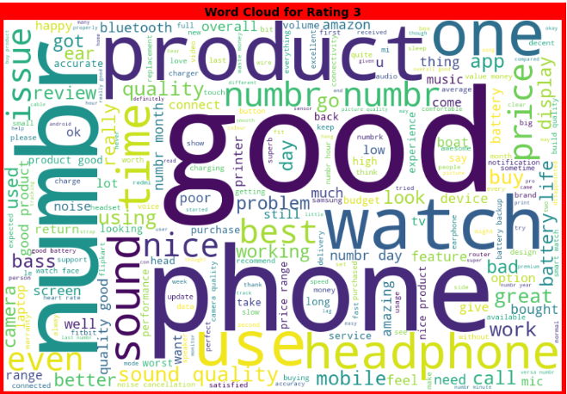

Slide 12
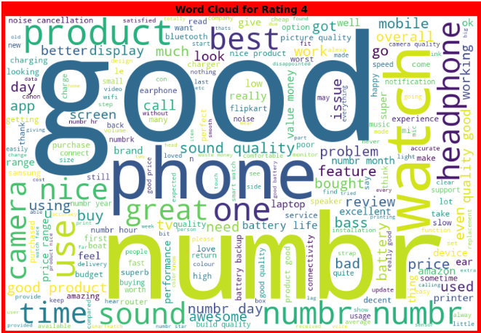

Slide 13
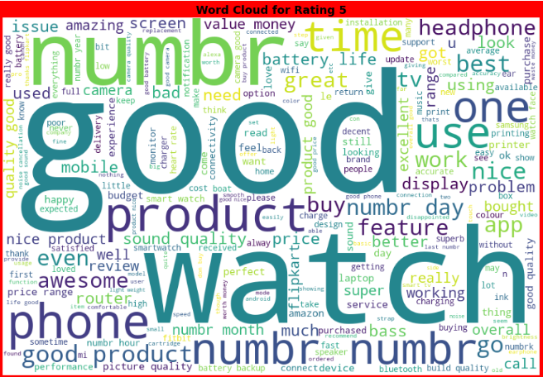

Slide 14
Building Models
Before applying the algorithms data encoding has to be done for textual data.
The different regression algorithm used in this project to build ML model are as below:
- Logistic Regression
- KNeighbors Classifier
- Decision Tree Classifer
- Ada Boost Classifier
- Gradient Boosting Classifier
- Random Forest Classifier
- MultinomialNB

Slide 15
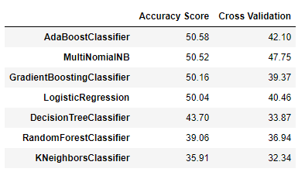
Best Model?
We are going to select Logistic Regression model as our best model because of its good recall for all the classes of target variable when compared with other algorithmic models.

Slide 16
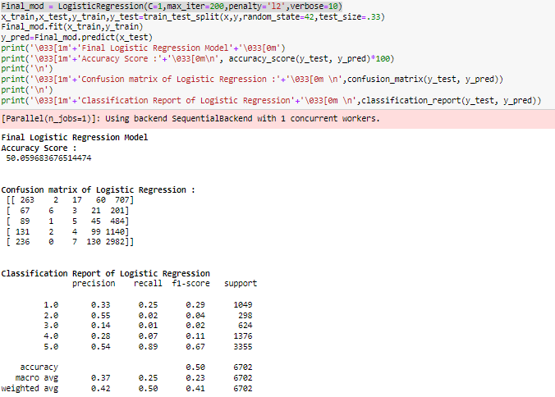
- Final model after hyperparameter tuning:

Slide 17
Conclusion:
The accuracy can be low due to some dataset issues.
One of the reason for such low accuracy can be the imbalanced target variable.
One can opt for any of the resample methods to fix this issue for a better accuracy.
More input features can be scrap to build predication model.
There is scope for application of advanced deep learning NLP tool to enhanced text mining operation which eventually help in building more accurate model with good cross validation score.
An extensive hyperparameter tuning can result in better model.

